Slide 1
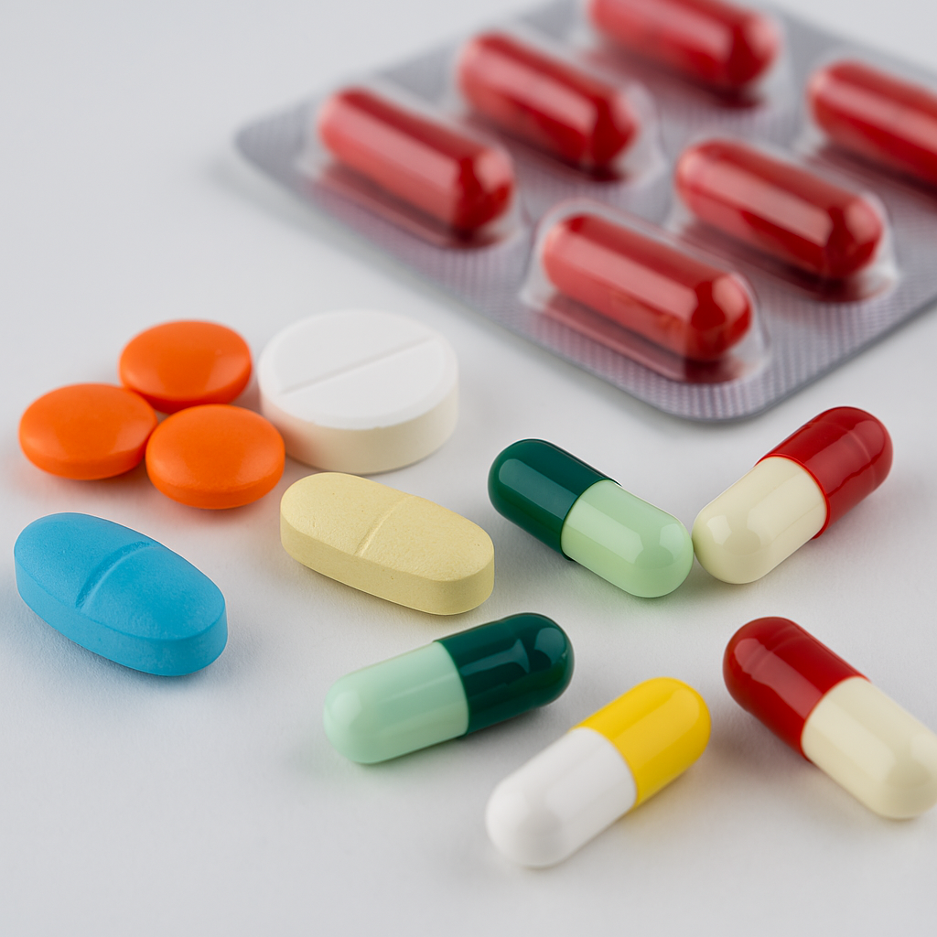
healwise
Sahil
Jigar
Yash
Divyesh

Slide 2

About Project
HealWise is a machine learning project that predicts the right drug for a patient based on health data like age, blood pressure, cholesterol, and Na_to_K ratio. Using a Random Forest model, it achieved 100% accuracy and can assist doctors in making fast, accurate, and data-driven prescriptions.

Slide 3
Problem
Problem Statement
Why This Problem Matters
Choosing the right drug for a patient is crucial for effective treatment and safety.
This project aims to build a machine learning model that predicts the most suitable drug based on a patient’s health data, such as age, blood pressure, cholesterol, and sodium-to-potassium ratio, helping doctors make faster and more accurate prescription decisions.
Choosing the right drug is essential for effective treatment and patient safety. Wrong prescriptions can lead to side effects or ineffective care. A prediction model helps doctors make faster, more accurate decisions, reducing errors and improving overall healthcare quality.

Slide 4


Source of Data & stakeholders
Source of Data
stakeholders
The dataset was taken from Kaggle, a popular platform for data science projects.
It contains patient health information such as age, sex, blood pressure, cholesterol level, and sodium-to-potassium (Na_to_K) ratio.
The goal is to use this data to predict the correct drug for each patient.
https://www.kaggle.com/datasets/prathamtripathi/drug-classification
Doctors: Use the model for quick and accurate drug prescriptions.
Hospitals/Clinics: Improve treatment efficiency and consistency.
Patients: Get safer and more personalized medication.
Health App Developers: Integrate the model into medical apps.
Medical Researchers: Use insights for drug effectiveness studies.

Slide 5
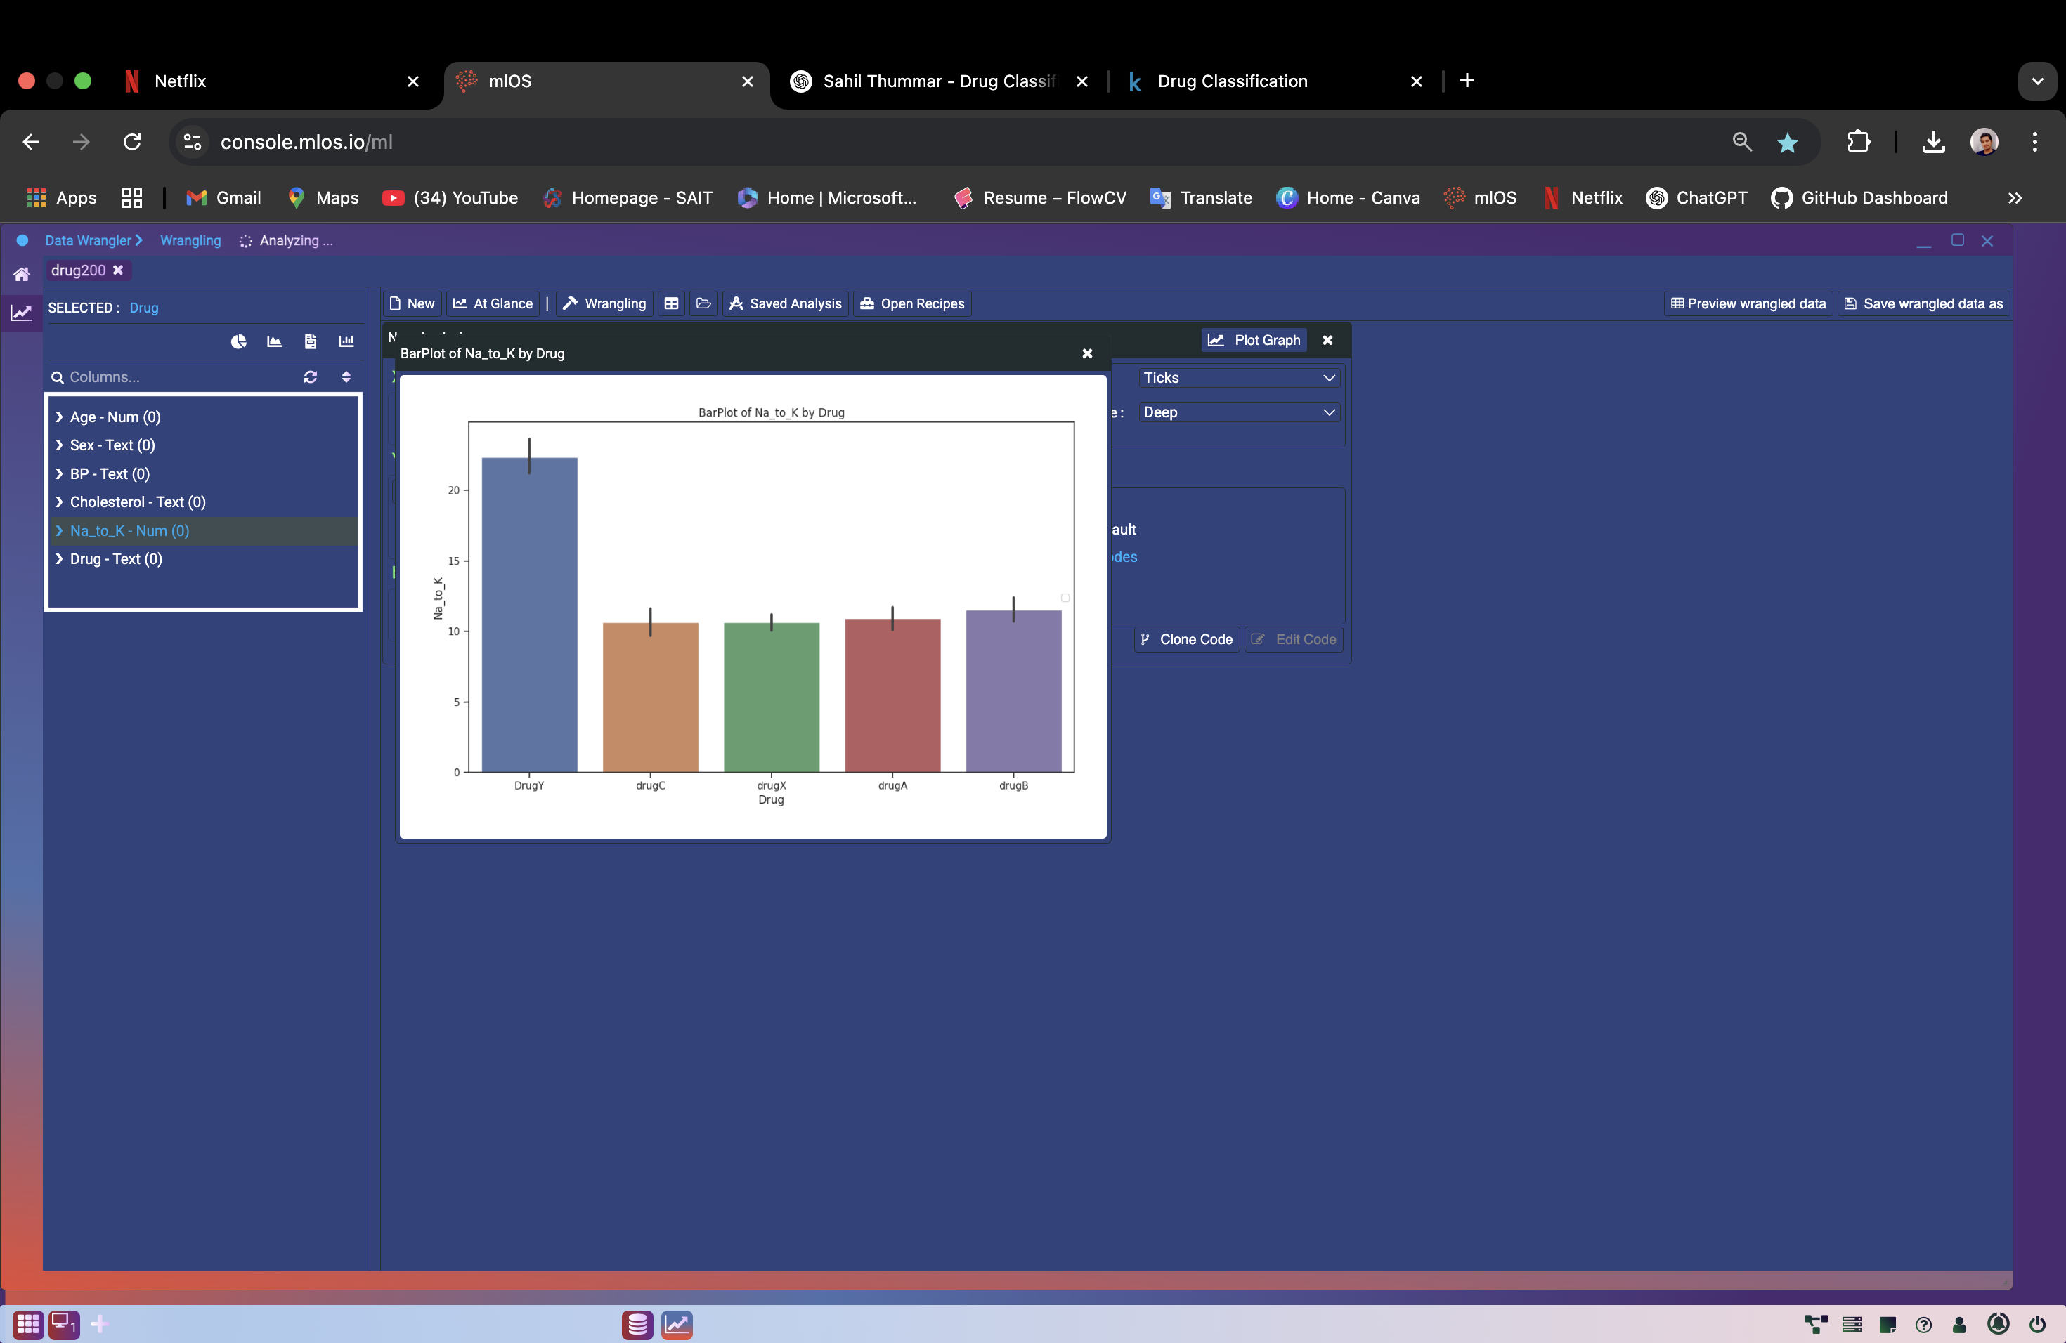
Methodology: Supervised Learning Classification
Exploratory Data Analysis (EDA):
Explored feature distributions and relationships.
Found no missing values in the dataset.
Identified Na_to_K as the most influential feature for drug prediction.
Visualizations showed DrugY is linked to high Na_to_K (sodium-to-potassium )values.
Handling Missing Data
Since the data was clean, we didn’t need imputation.
This helped us proceed directly to modeling without extra preprocessing.

Slide 6
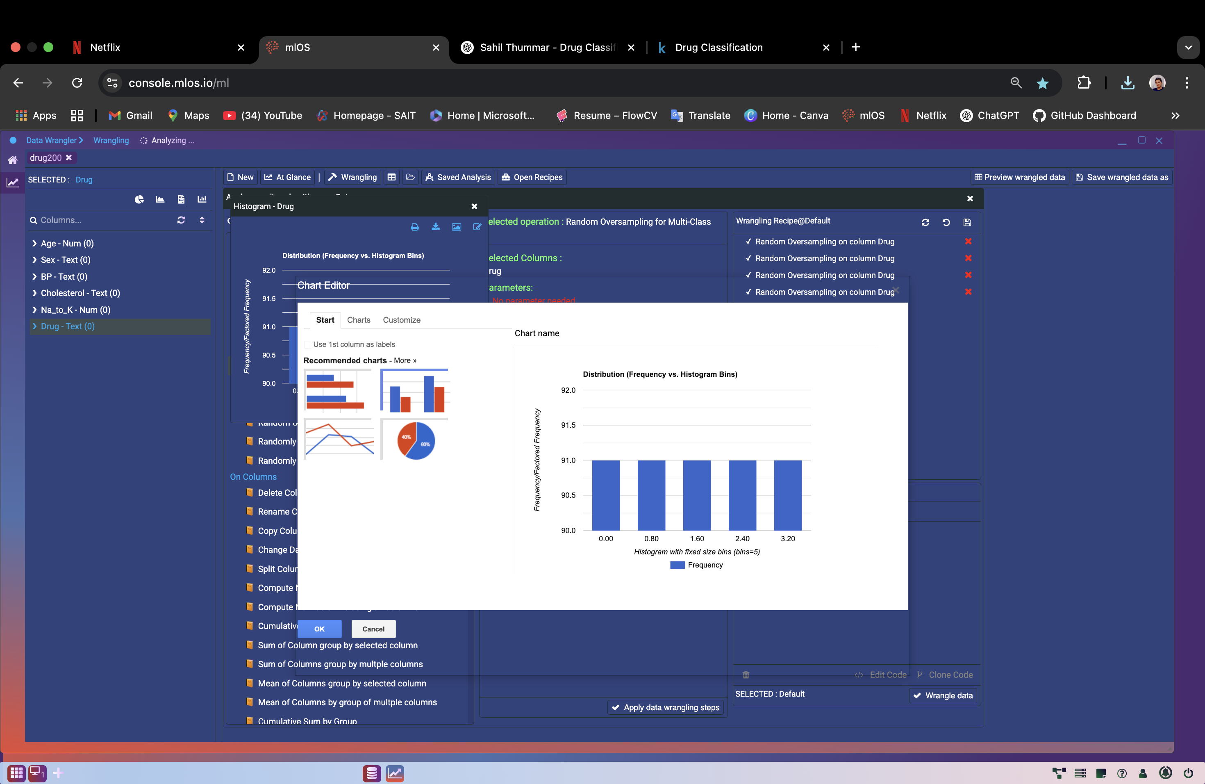
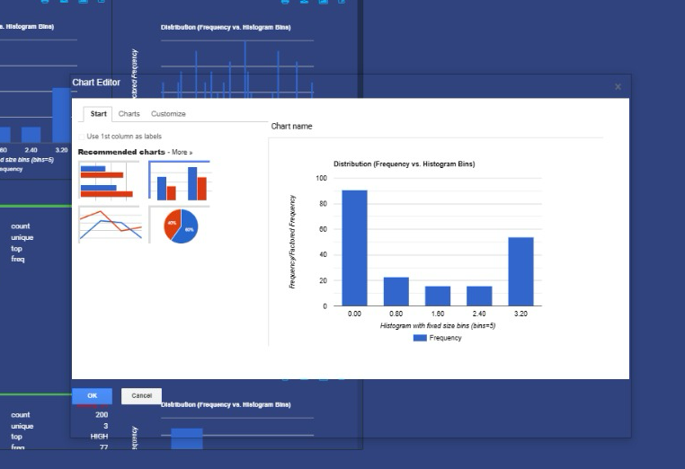
Balancing the Dataset
Noticed imbalance in drug categories.
Applied oversampling to balance the drug classes, especially for underrepresented drugs.

Slide 7
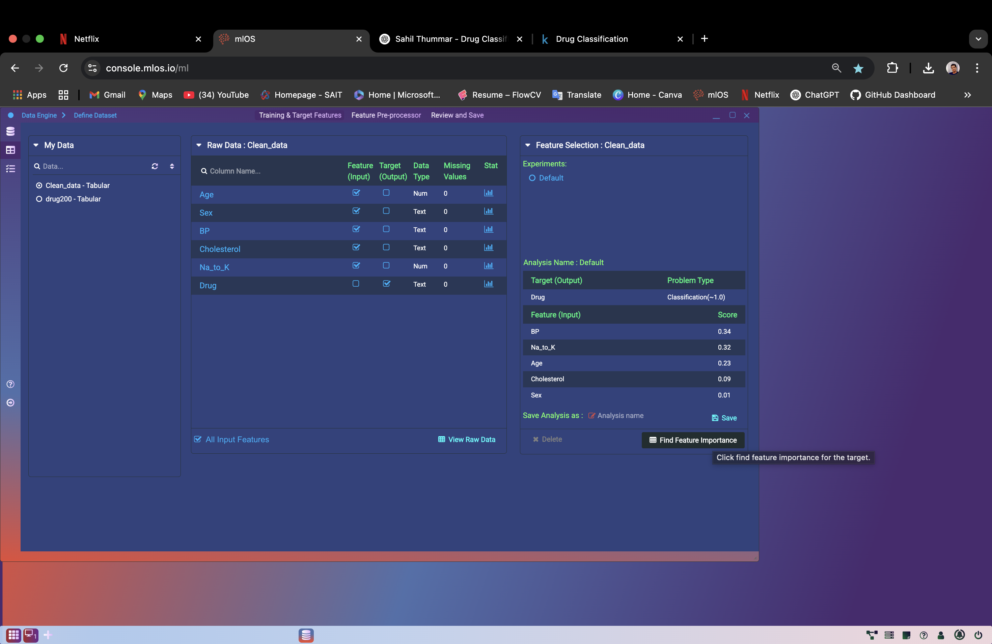
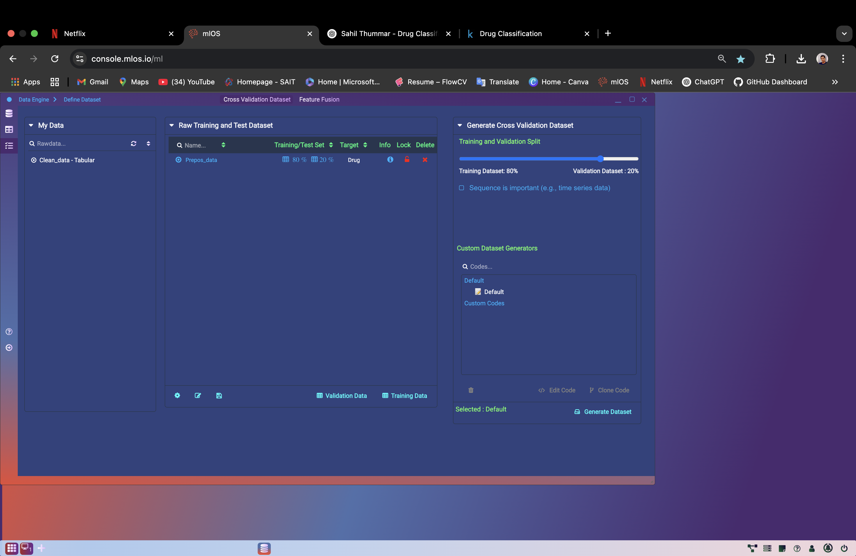
Data Preparation
Split data into 80% training and 20% testing for evaluation.
Performed feature selection to keep only important variables.
Applied normalization to scale numerical features for better model performance.

Slide 8
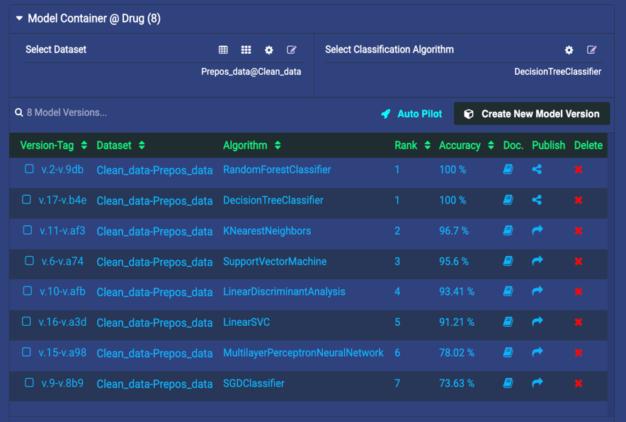
Modeling Process
Tried several classification algorithms (e.g., Logistic Regression, Decision Tree).
Random Forest Classifier was chosen due to highest accuracy (100%).
Its ability to handle both categorical and numerical features, and reduce overfitting, made it ideal for this problem.

Slide 9

Results
How And Why This Model Selected???

Slide 10
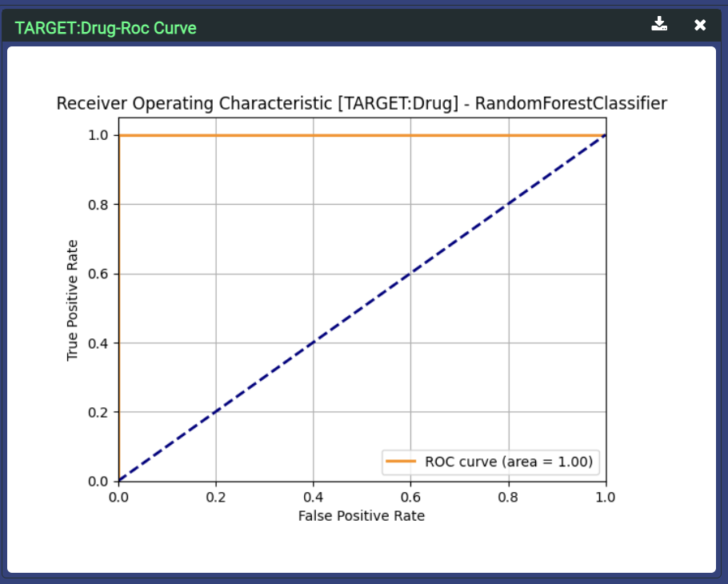
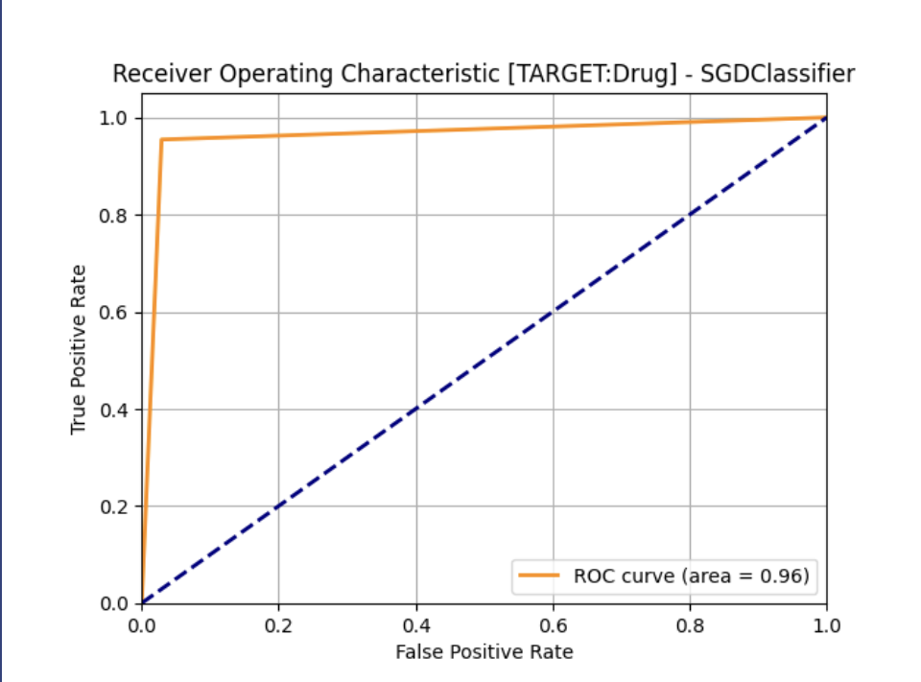
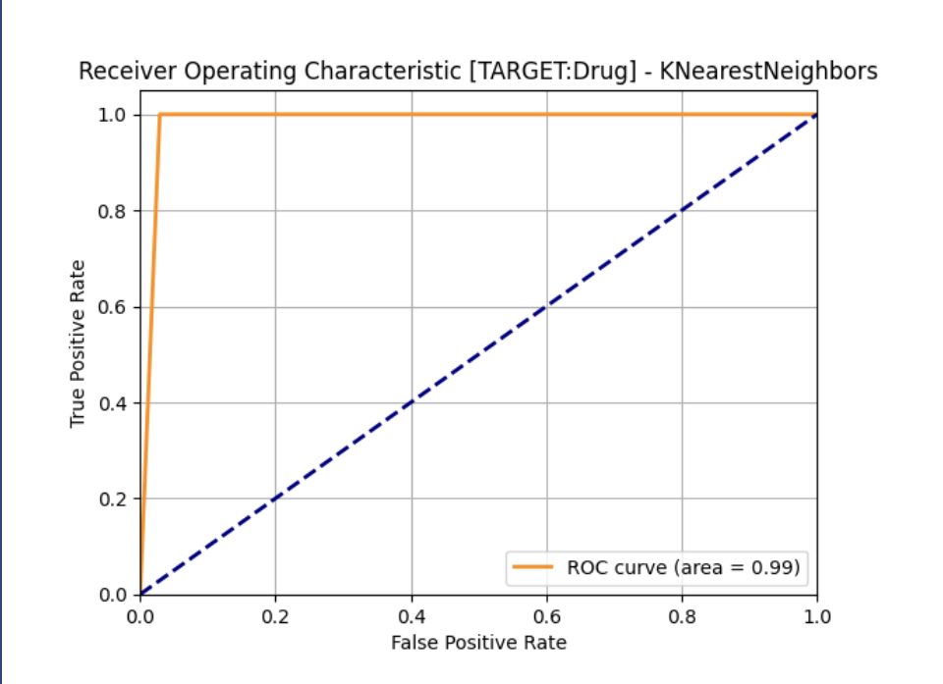

Slide 11

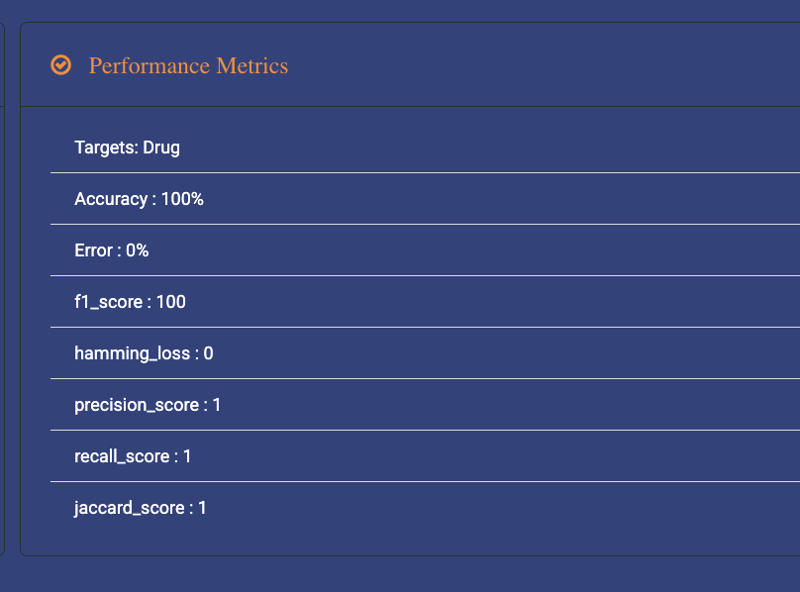
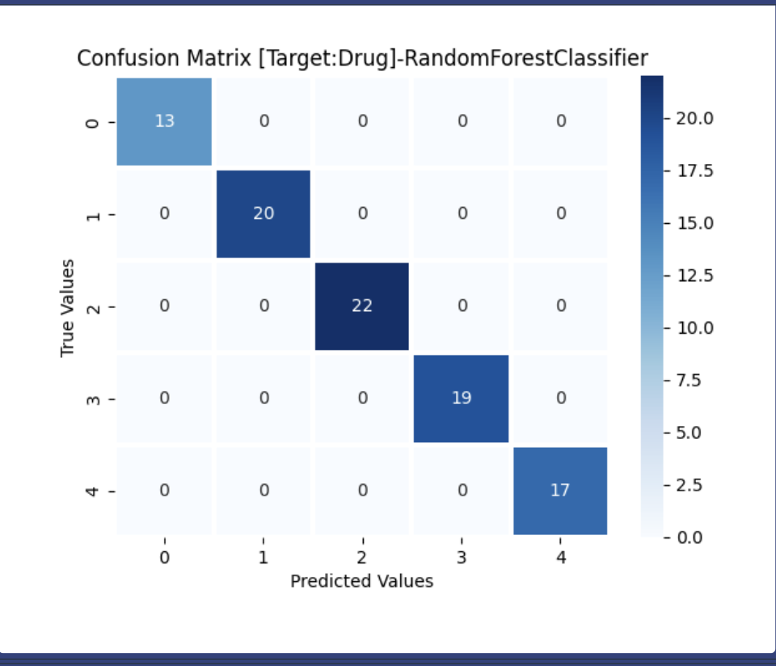
The Random Forest Classifier gave the best performance among all tested models.
It achieved 100% accuracy on the test data.
Key metrics were perfect:
Precision: 1.0
Recall: 1.0
F1 Score: 1.0
Hamming Loss: 0
Jaccard Score: 1.0
The model made no errors and classified all drug types correctly.
These results show the model is highly reliable and suitable for real-world use in predicting drug prescriptions.

Slide 12

model governance and deploy

Slide 13
Model Sharing and Acceptance
The Drug Classification model was shared with instructor through the mLOS platform for review.
It was accepted due to its perfect performance, achieving:
100% Accuracy
1.0 Precision, Recall, and F1-score
The model was trusted due to its explainability and consistent results across metrics.

Slide 14
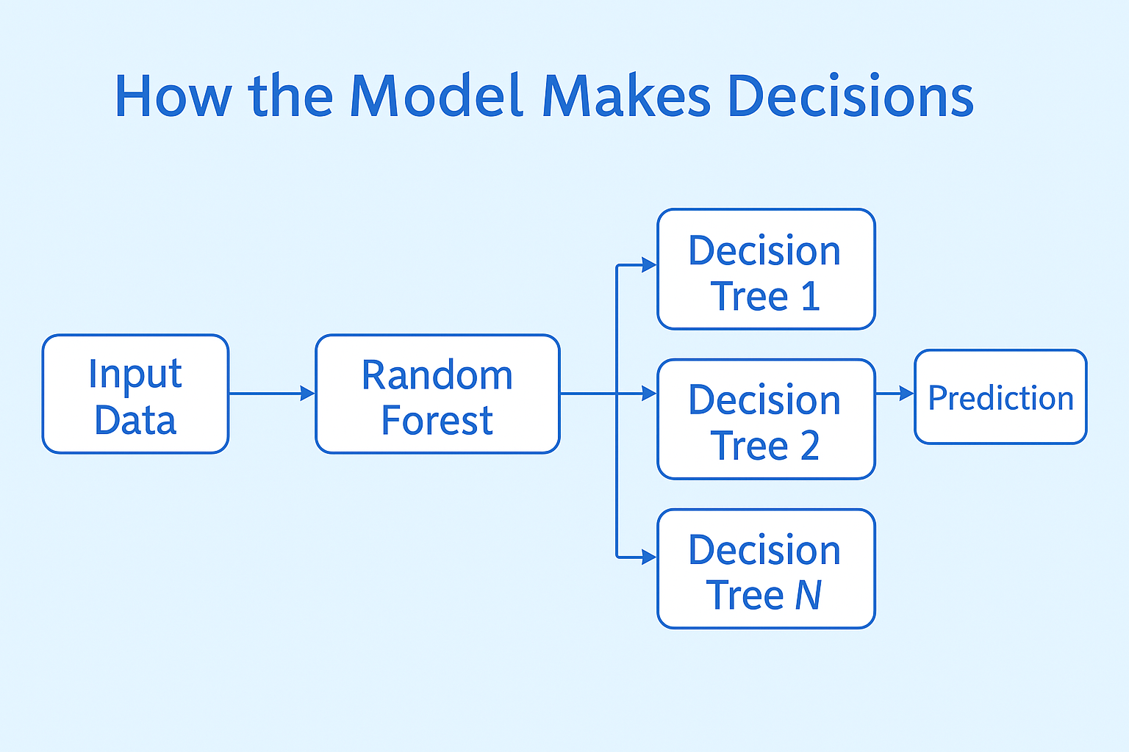
How the Model Makes Decisions
The model uses Random Forest, which combines many decision trees.
Each tree looks at patient data (like Na_to_K, blood pressure, cholesterol, etc.) and makes a prediction.
The final decision is based on majority voting — the most suggested drug is selected.
This method improves accuracy, avoids errors from individual trees, and gives stable predictions.
The feature Na_to_K was found to be the most important in predicting the drug.

Slide 15
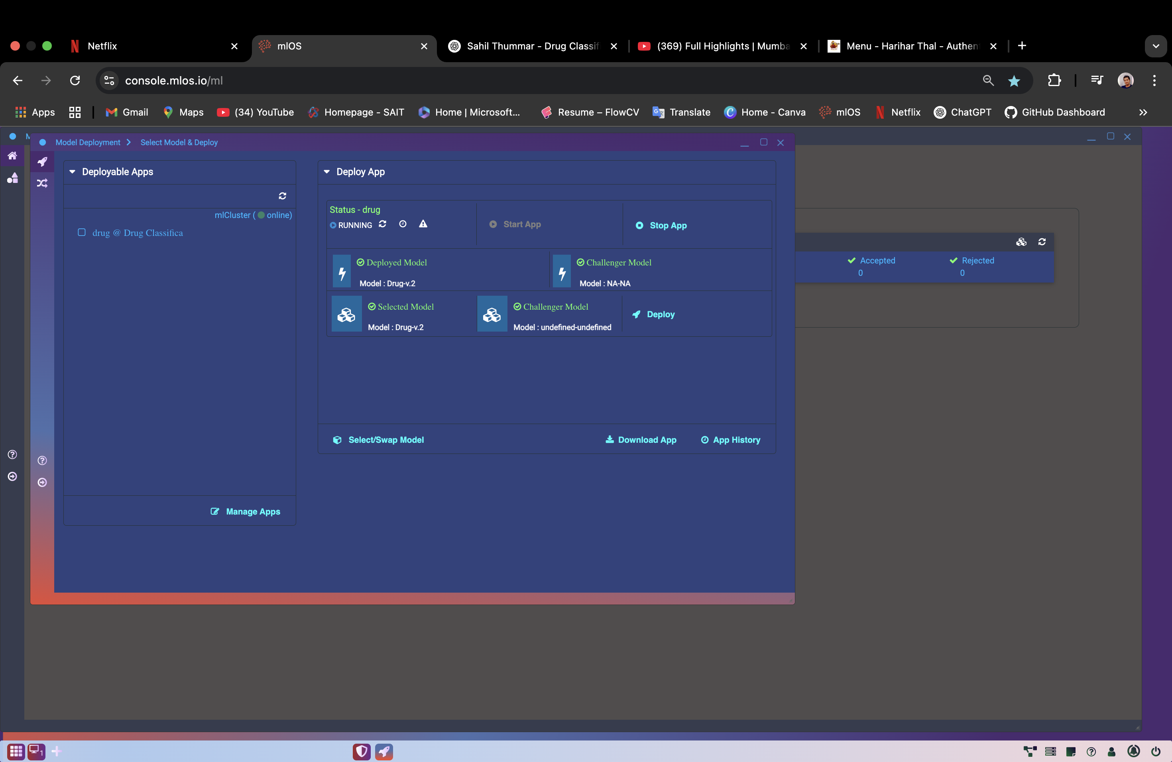
Model Deployment
The trained Random Forest drug classification model was deployed using the mLOS platform.
The deployment interface allows selecting and assigning the best-performing model for production use.
In this case, the selected model is Drug-v2, which showed 100% accuracy in testing.
Once deployed, the model can be integrated with apps or dashboards for real-time drug prediction based on patient input.
file:///Users/sahilthummar/Downloads/HEALWISE_LIGHTBLUE_THEME_UPDATED.html

Slide 16
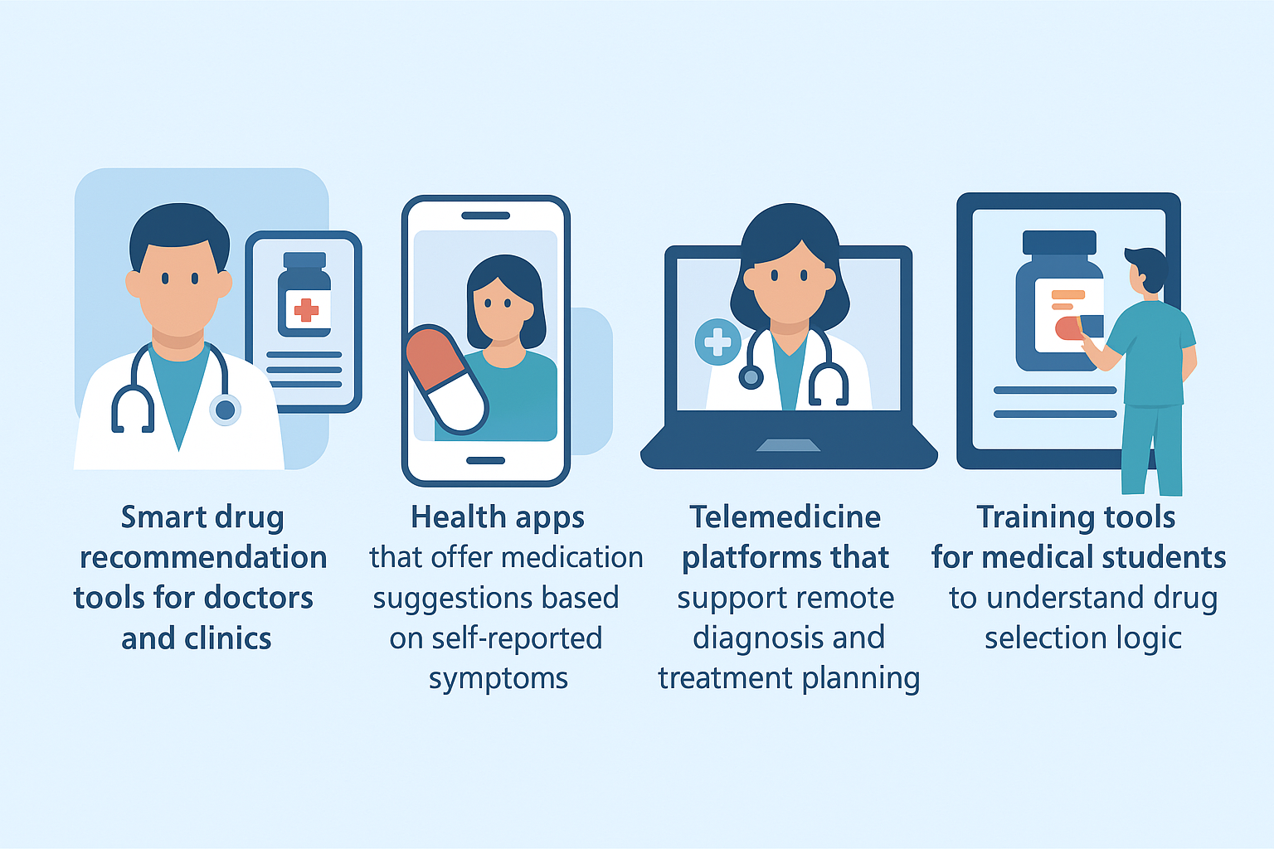
Real word use cases

Slide 17
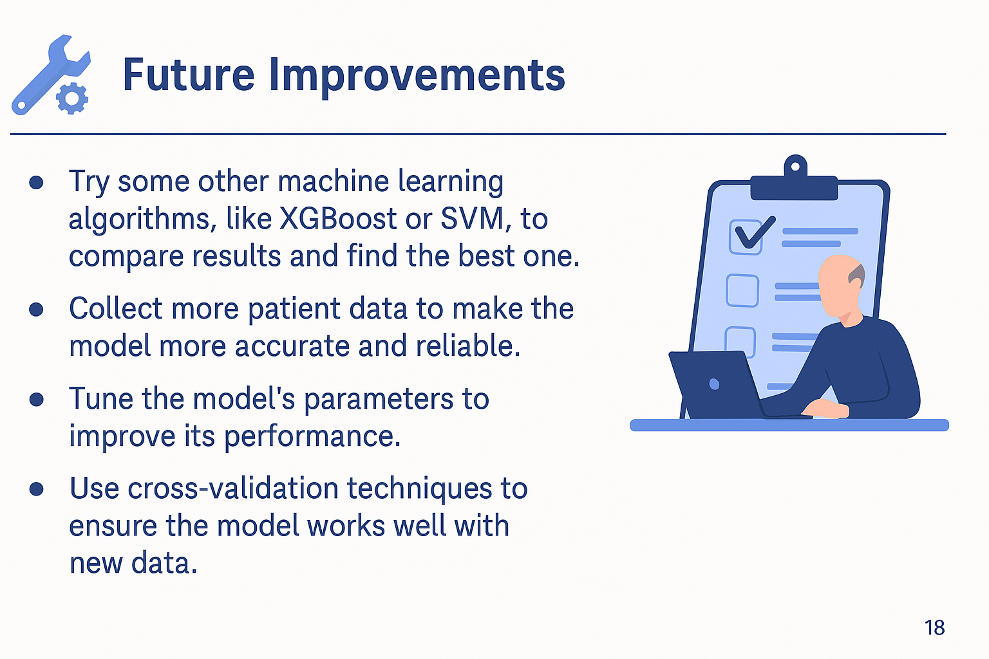
Real word use cases

Slide 18
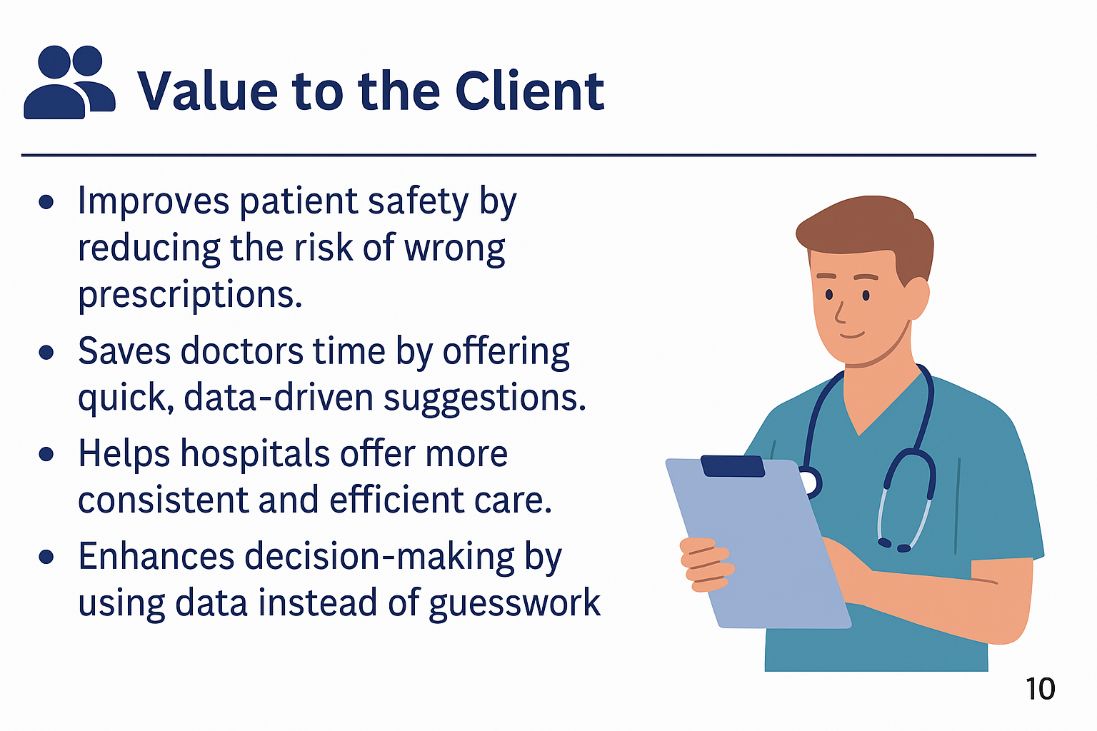
Real word use cases

Slide 19
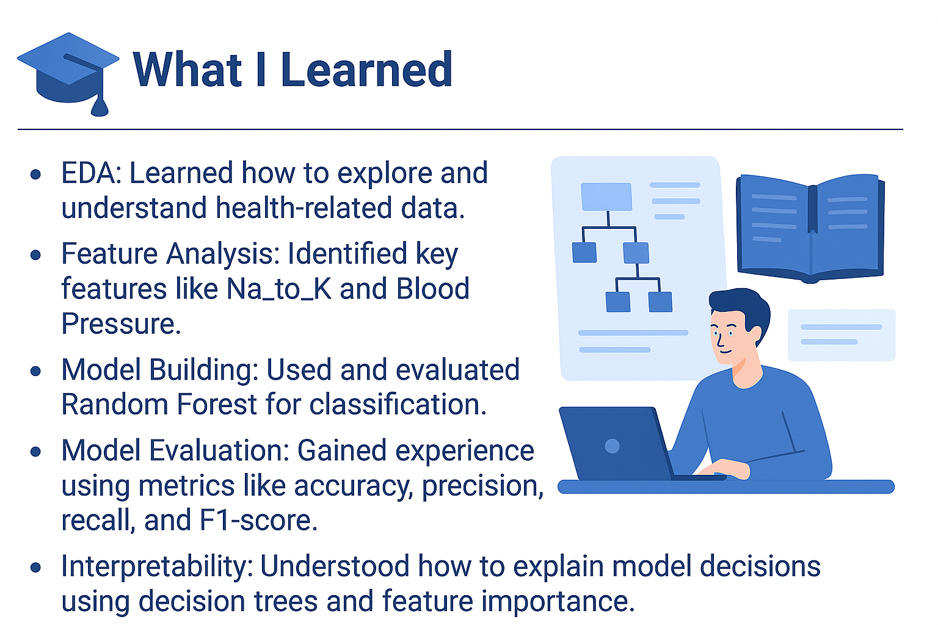
Real word use cases

Slide 20
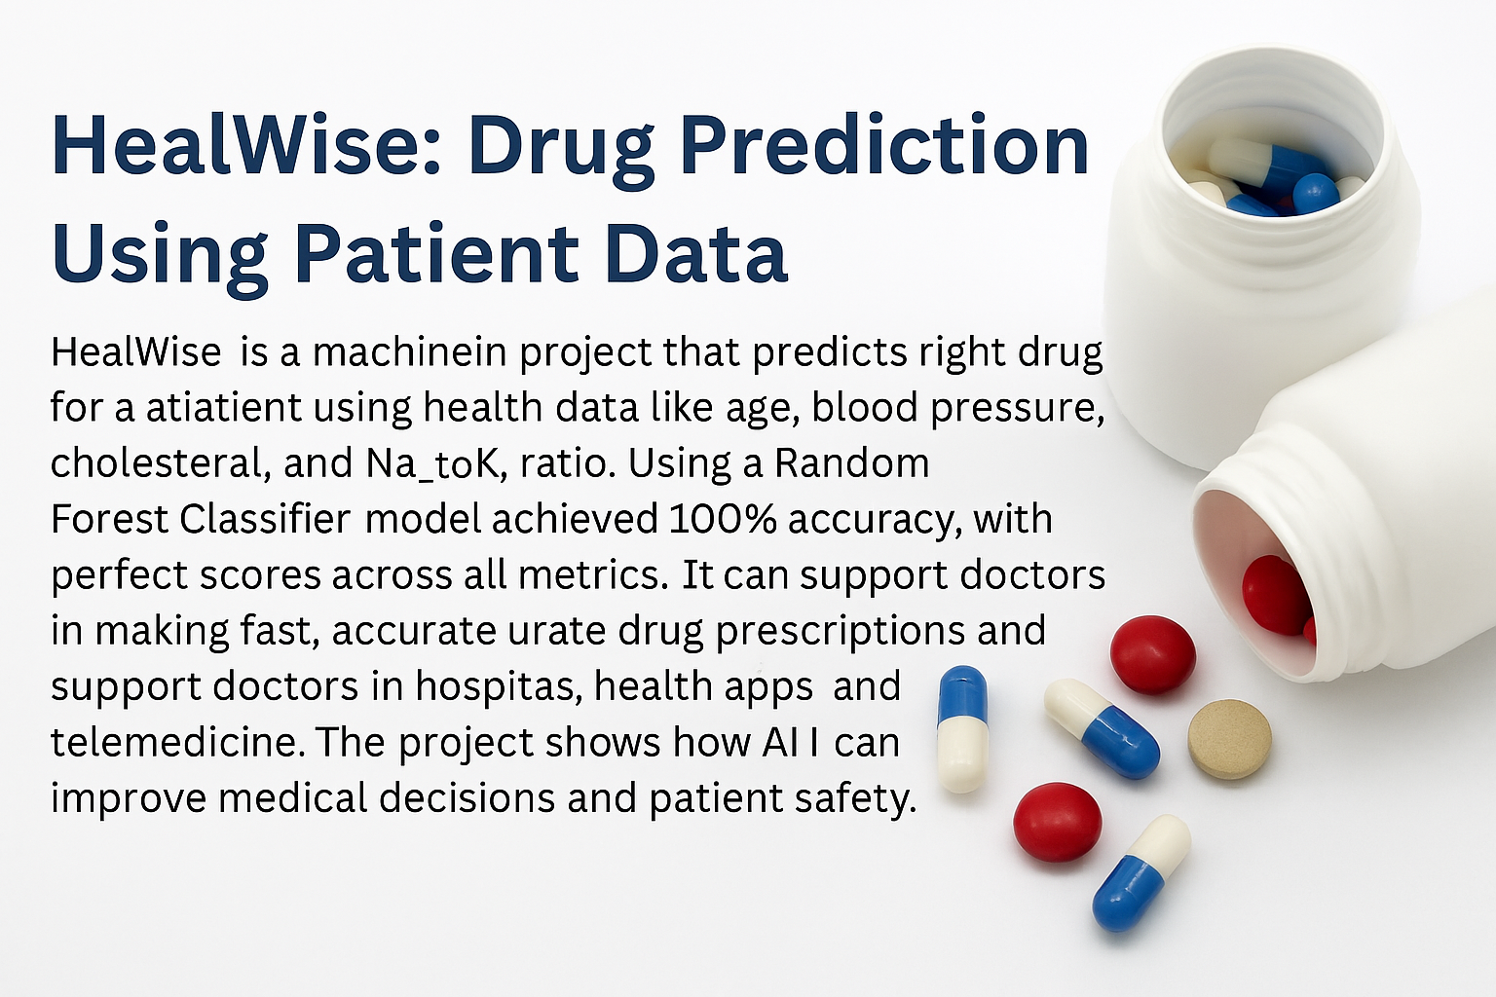

Slide 21

THANK YOU

